Slide 1
Our Mission
Along with our community of participants, we actively research new drugs and interventions to prevent cancer by conducting and participating in new clinical studies.
Join the Fight.
Prevent Cancer Now!
[Insert Tagline]
Name of Clinical Site Address 1
Address 2 City, State, Zip Code
(000) 000-0000
Website: www.sample.com
Email: email@sample.com
Facebook.com/sample
Twitter: @sample
Cancer Prevention Clinical Trials At [Name Of Clinical Site]
_________________________________________
[Optional - Insert driving directions, local map, parking, and/or information about nearby public transportation]
_________________________________________
This study is funded by a contract from the National Cancer Institute, National Institutes of Health, U.S. Department of Health and Human Services.

Slide 2
Benefits of Enrolling
Delay or prevent your own disease.
Gain access to new research treatments/procedures immediately.
Play an active role in your own health.
Receive regular and careful care from medical professionals and specialists.
Contribute to cancer prevention research.
Become part of the cancer prevention community and make a difference.
Our Study Team
Clinical Trials are conducted by [Name of Principal Investigator] who has more than [years] of experience in [related expertise], as well as an experienced, competent, and caring team of nurses and professionals including a dedicated study coordinator.
Our team provides trial participants with the highest standard of care.
Our Community
At [Name of Clinical Site], we are a community of trial participants and medical professionals working together to prevent cancer.
We are looking forward to welcoming new participants to help make our mission a success.
Cancer Prevention Certain types of cancer take years to develop and there is an opportunity to intervene early in the process. The best opportunity to slow, stop, or reverse cancer development is with cancer prevention clinical trials.
[Name of Clinical Site] is conducting cancer prevention clinical trials sponsored by the National Cancer Institute, (NCI), Division of Cancer Prevention (DCP) in the [City/Region] area.
What is a Clinical Trial?
A clinical trial is a research study that investigates the safety and efficacy of health-related interventions in humans. New treatments may include new drugs or new combinations of drugs, vaccines, devices, and new surgical procedures.
Cancer Facts
1.6
Million
Number of new cases of cancer that will be diagnosed in 2015 in the United States
589,430
Number of individuals who will die from the disease in the United States this year.
1,900+
Number of children and adolescents who died from the disease in 2014.
Next Steps
Schedule an appointment today to find out if you are eligible!
(800) 555-1234
join@xyzClinic.com
www.xyzClinic.com
39%
Percent of men and women who will be diagnosed with cancer at some point during their lifetime.

Slide 3
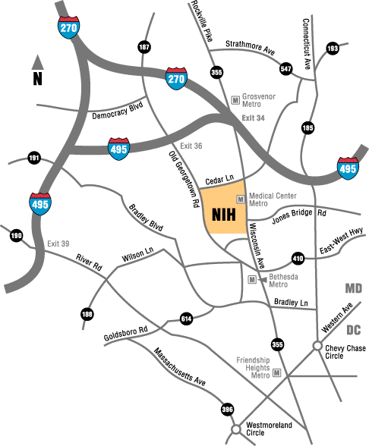
Our Mission
Along with our community of participants, we actively research new drugs and interventions to prevent cancer by conducting and participating in new clinical studies.
Join the Fight.
Prevent Cancer Now!
When it comes to preventing
cancer
come out swinging.
xyzClinic 123 Anywhere Street
Bethesda, MD, 12345
(800) 555-1234
Website: www.xyzClinic.com
Email: join@xyzClinic.com
Facebook.com/xyzClinic
Twitter: @xyzClinic
Metro Accessible:
xyzClinic is located two blocks south of the Bethesda Metro Station.
Parking:
Street parking and public parking garages are located nearby.
Cancer Prevention Clinical Trials At
This study is funded by a contract from the National Cancer Institute, National Institutes of Health, U.S. Department of Health and Human Services.

Slide 4
Cancer Prevention Certain types of cancer take years to develop and there is an opportunity to intervene early in the process. The best opportunity to slow, stop, or reverse cancer development is with cancer prevention clinical trials.
[Name of Clinical Site] is conducting cancer prevention clinical trials sponsored by the National Cancer Institute, (NCI), Division of Cancer Prevention (DCP) in the [City/Region] area.
What is a Clinical Trial?
A clinical trial is a research study that investigates the safety and efficacy of health-related interventions in humans. New treatments may include new drugs or new combinations of drugs, vaccines, devices, and new surgical procedures.
Benefits of Enrolling
Delay or prevent your own disease.
Gain access to new research treatments/procedures immediately.
Play an active role in your own health.
Receive regular and careful care from medical professionals and specialists.
Contribute to cancer prevention research.
Become part of the cancer prevention community and make a difference.
Our Study Team
Clinical Trials are conducted by [Name of Principal Investigator] who has more than [years] of experience in [related expertise], as well as an experienced, competent, and caring team of nurses and professionals including a dedicated study coordinator.
Our team provides trial participants with the highest standard of care.
Our Community
At [Name of Clinical Site], we are a community of trial participants and medical professionals working together to prevent cancer.
We are looking forward to welcoming new participants to help make our mission a success.
Cancer Facts
1.6
Million
Number of new cases of cancer that will be diagnosed in 2015 in the United States
589,430
Number of individuals who will die from the disease in the United States this year.
1,900+
Number of children and adolescents who died from the disease in 2014.
Next Steps
Schedule an appointment today to find out if you are eligible!
(800) 555-1234
join@xyzClinic.com
www.xyzClinic.com
39%
Percent of men and women who will be diagnosed with cancer at some point during their lifetime.

